Slide 1
Python – File Handling
Premanand S

Slide 2
File
Files are any named location on disk to store some information
Example: Powerpoint, Word, PDF or text formats
In normal, any file can be create, read, update and even delete the files.
Files can be TEXT based or BINARY based formats

Slide 3
File operations
Open a file
Read or Write a file
Close the file

Slide 4
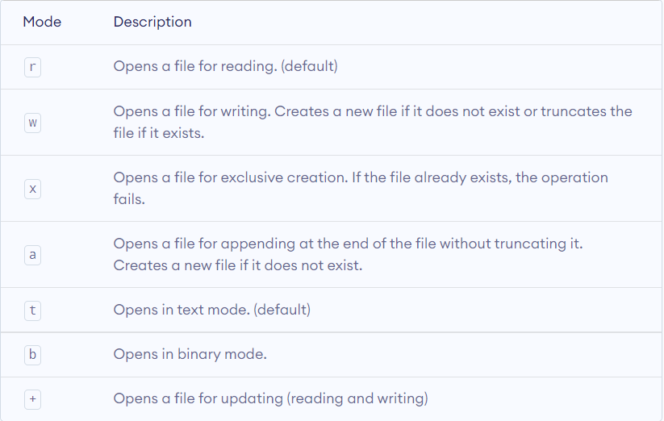
Open a file
Open (filename, mode)
Open() – return a file object

Slide 5


